Slide 2
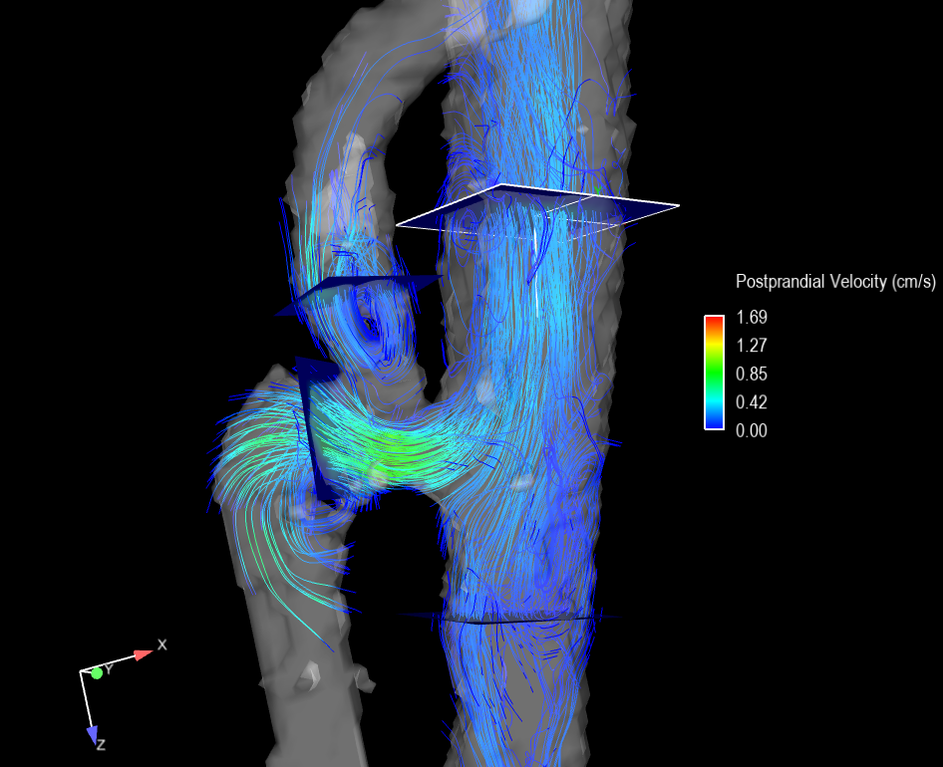
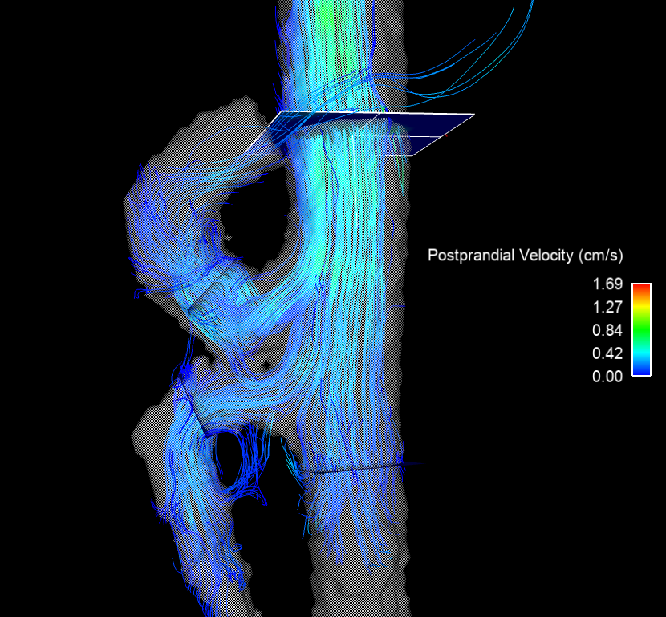
Median Arcuate Ligament Syndrome
a)
Post-surgery
b)
SCAo
b)
SCAo
CA
SMA
CA
SMA
IRAo
IRAo

Slide 3
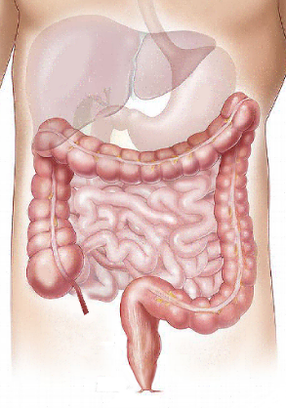
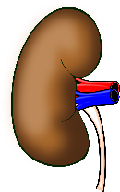
Meal Response in Control (N=20) and Ischemia Group (N=6)
Supraceliac Aorta
Portal Vein
Meal Response (Percent Change)
Control % Change: +15.7
Control % Change: +56.7
Ischemia % Change: -2.6
+100 %
Celiac Artery
Bowel
Ischemia % Change: +11.8
Control % Change: +5.3
Ischemia % Change: +4.5
0 %
Superior Mesenteric Artery
Splenic Vein
Control % Change: +98.8
Control % Change: -4.8
Ischemia % Change: +23.5
-100 %
Ischemia % Change: -11.7
Right Renal Artery
Left Renal Artery
Control % Change: +7.0
Control % Change: +3.5
Ischemia % Change: -35.7
Ischemia % Change: -19.9
Control % Change: +132.5
Ischemia % Change: +40.3
Control % Change: -10.0
Superior Mesenteric Vein
Ischemia % Change: -3.2
Infrarenal Aorta

Slide 4
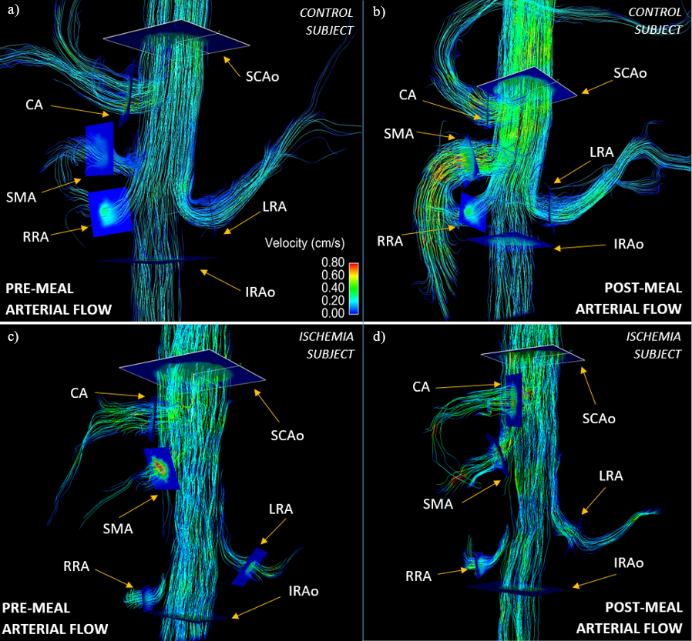

Slide 5
